Slide 1
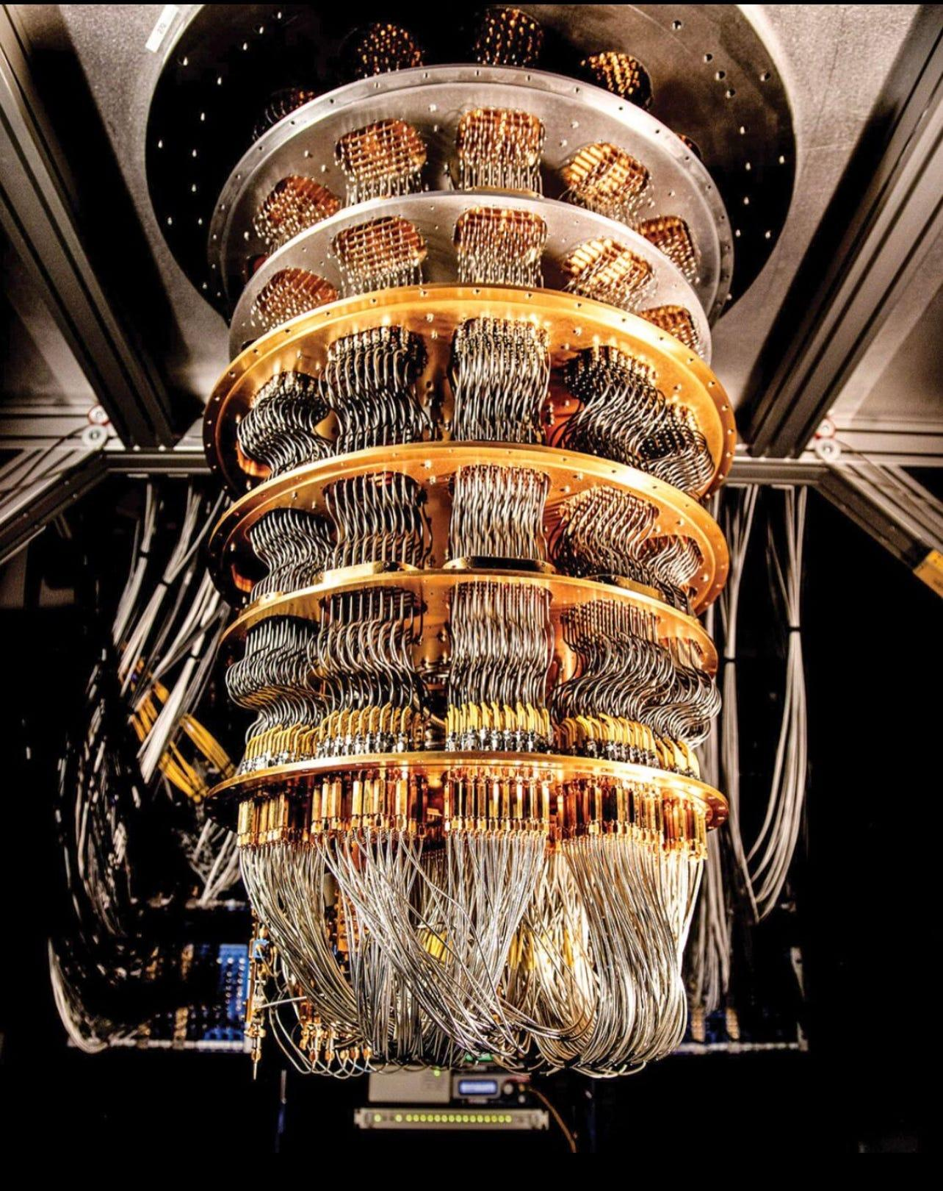
Functional Paradigms in Quantum Computing
GitHub Link

Slide 2
Team - 5
Saanvi Vishal (IMT2021043)
Arjun Subhedar (IMT2021069)
Ritik Kumar Gupta (IMT2021098)
Pandey Shourya Prasad (IMT2021535)

Slide 3
Table of contents
01
02
03
04
05
06
About Quantum Computing
Grover’s Algorithm
Shor’s Algorithm and Fourier Transform
Functional Quantum Algorithm Framework for Shor’s
Comparing Functional & Imperative Implementation in QC
Challenges Faced

Slide 4
Quantum Computing: What and Why?
Quantum computing uses specialized technology including computer hardware that uses principles of fundamental physics(quantum mechanics) to solve complex problem that classical computers or even supercomputers can’t solve, or can’t solve quickly.
Complex problems are problems with lots of variables interacting in complicated ways. Modeling the behavior of individual atoms in a molecule is a complex problem, because of all the different electrons interacting with one another.
The real world runs on quantum physics. Computers that make calculations by using the quantum states of quantum bits should in many situations be our best tools for understanding it.

Slide 5
Why are Quantum Computers faster?
A classical computer/supercomputer might try to simulate molecular behavior with brute force, by using its many processors to explore every possible way every part of the molecule might behave. No computer has the working memory to handle all the possible permutations of molecular behavior by using any known methods
Quantum algorithms try a different method for solving tough problems by making multi-dimensional spaces for calculations.
In regular computers, information is stored and processed in a linear way. But in quantum computing, information can exist in multiple states at once.

Slide 6
Basic Terms of QC to Know:
Qubit: Quantum bit, the basic unit of quantum information. Unlike classical bits (0 or 1) qubits can exist in multiple states simultaneously due to superposition.
Superposition: A fundamental principle where a qubit can be in a combination of states simultaneously, rather than being restricted to just one state like classical bits.
Entanglement: When qubits become correlated with each other in such a way that the state of one qubit depends on the state of another, even when they are physically separated.
Quantum Gate: Analogous to classical logic gates, quantum gates manipulate qubits to perform operations necessary for computation. Examples include the Hadamard gate and the CNOT gate.
Measurement: The process of extracting classical information from a quantum system, which causes the collapse of the superposition into a definite state.

Slide 7

Grover’s Algorithm

Slide 8
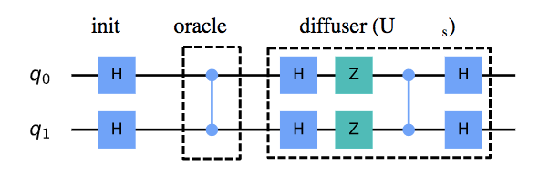
Grover’s Algorithm (1)
Grover’s algorithm is a quantum algorithm that solves the unstructured search problem. In an unstructured search problem, given a set of N elements and want to find a single marked element. A classical computer would need to search through all N elements in order to find the marked element, which would take time O(N). Grover’s algorithm, on the other hand, can find the marked element in time O(√ N).
Grover’s Algorithm Circuit

Slide 9
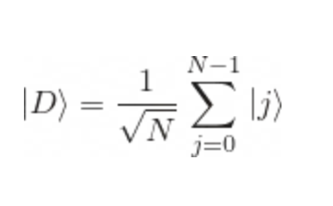
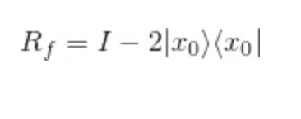

Grover’s Algorithm (2)
Let’s denote the element we want to find as |x₀>. Functions implemented as an oracle (Rf) and a diffusion operator (RD) respectively. Rf applies a negative sign before |x₀> and leaves all the other states as it is and RD applies a negative sign to all states orthogonal to the state |00…0>.
In Grover’s algorithm we start with a state which is the superposition of all the n-qubit states, let’s call this state |D>, we then apply Rf followed by RD.

Slide 10
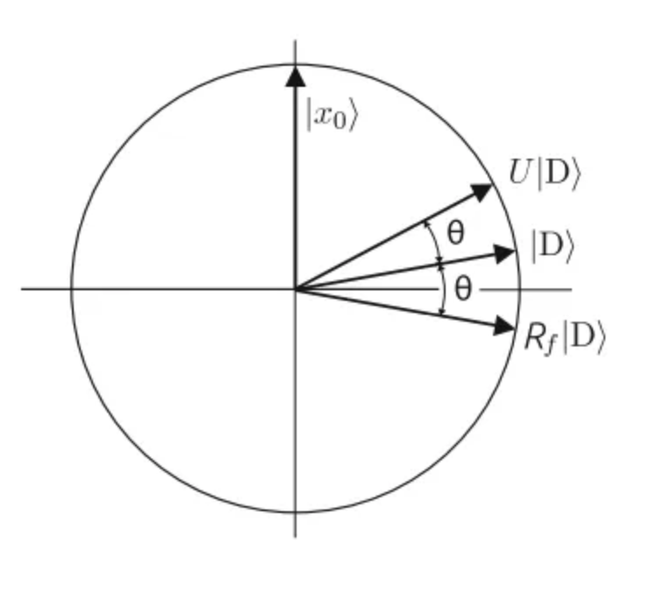
Grover’s Algorithm (3)
Let’s assume a 2-D subspace where the y-axis is the vector |x₀> and the x-axis denotes all the vector orthogonal to |x₀>. We have |D> making an angle of θ/2 with the x-axis.
We first apply the Rf operator which reflects the state |D> about the x-axis and gives the state Rf |D> then we apply the RD operator which reflects the state about |D>.

Slide 11
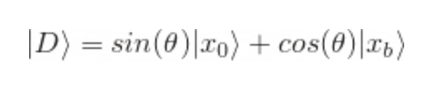
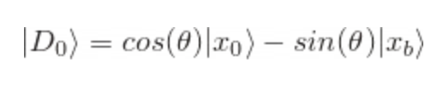
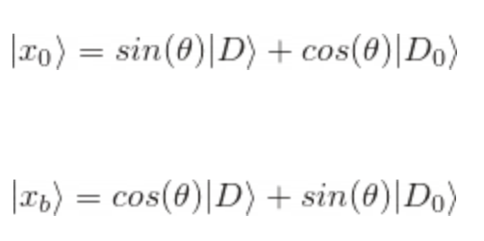
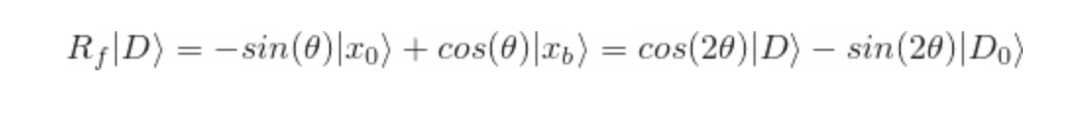
Grover’s Algorithm Analysis (1)
|xb> is the vector orthogonal to |x₀>, i.e. x axis represented in the 2D subspace
the conjugate of |D> can be written as follows ->
The search algorithm starts with the |D> state, then applying Rf will give the state ->

Slide 12
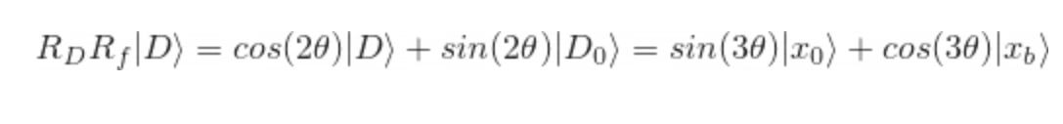
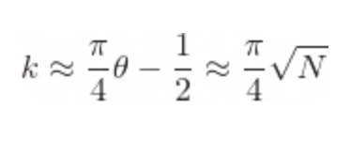
Grover’s Algorithm Analysis (2)
Then after applying operator RD we get the state ->
It is easy to verify by induction that after k iterations of the Grover iterator (U = RD.R𝒻) starting with state |D> = H|00…..0> we get ->
In order to obtain |x₀> with high probability we must select k such that sin((2k + 1)θ) ≈ 1, which means that we would like (2k + 1)θ ≈ π/2
We get the desired result after only k iterations and k is of the order of √N hence the time complexity of Grover's algorithm is O(√N)!

Slide 13
Shor’s Algorithm
Shor's algorithm is a quantum algorithm for finding the prime factors of an integer.
When the integers are very large, no efficient classical integer factorization algorithm is known. The hardest factorization problems are semiprime numbers, the product of two prime numbers.
The presumed difficulty of this semiprime factorization problem underlines many encryption algorithms, such as RSA, which is used in online credit card transactions, amongst other applications.

Slide 14
Role of Prime Factorisation in RSA
To use the RSA algorithm to encrypt a message, the sender first converts the message into a numerical form using a predetermined encoding scheme. The sender then raises this numerical value to the power of the public key and takes the result modulo the public key to produce the encrypted message.
The recipient can then use their knowledge of the prime factors of the public key to decrypt the message by raising the encrypted message to the power of a certain exponent and taking the result modulo the private key, which is derived from the prime factors of the public key.
Now the public key is known to everyone but its prime factors are not known. And since the private key is basically a function of the prime factors of the public key, the problem to decrypt the message becomes very difficult.

Slide 15
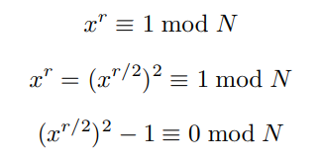

The Algorithm
Reduction of factorization of N to the problem of finding the period of an integer x less than N and greater than 1 depends on the following result from number theory: Theorem: The function F(a) = x^a mod N is a periodic function, where x is an integer coprime to N and a ≥ 0.
Since F(a) is a periodic function, it has some period r. Knowing that x^0 mod N = 1, this means that x^r mod N = 1 since the function is periodic, and thus r is just the first nonzero power where x^r = 1(modN).
Given this information and through the following algebraic manipulation.
From this, the product is an integer multiple of N. Thus, as long as both the multiples are not multiples of N, then at least one of them has a non-trivial factor with N, which gives us the answer.
The Quantum part of this algorithm comes from the period calculation, which is done by Quantum Fourier Transform.

Slide 16
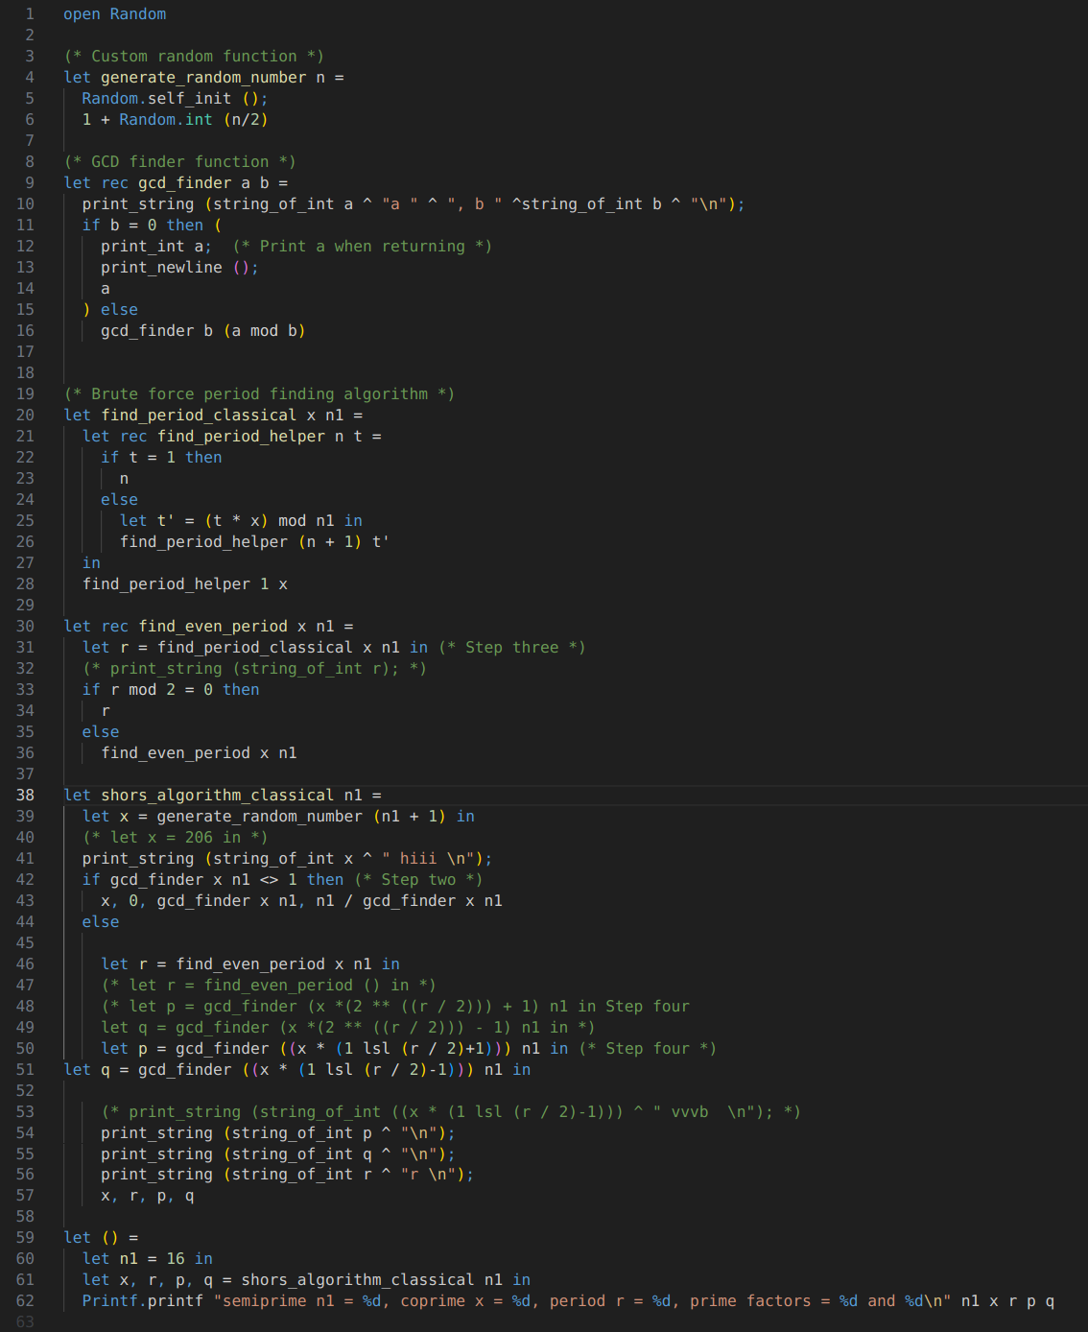
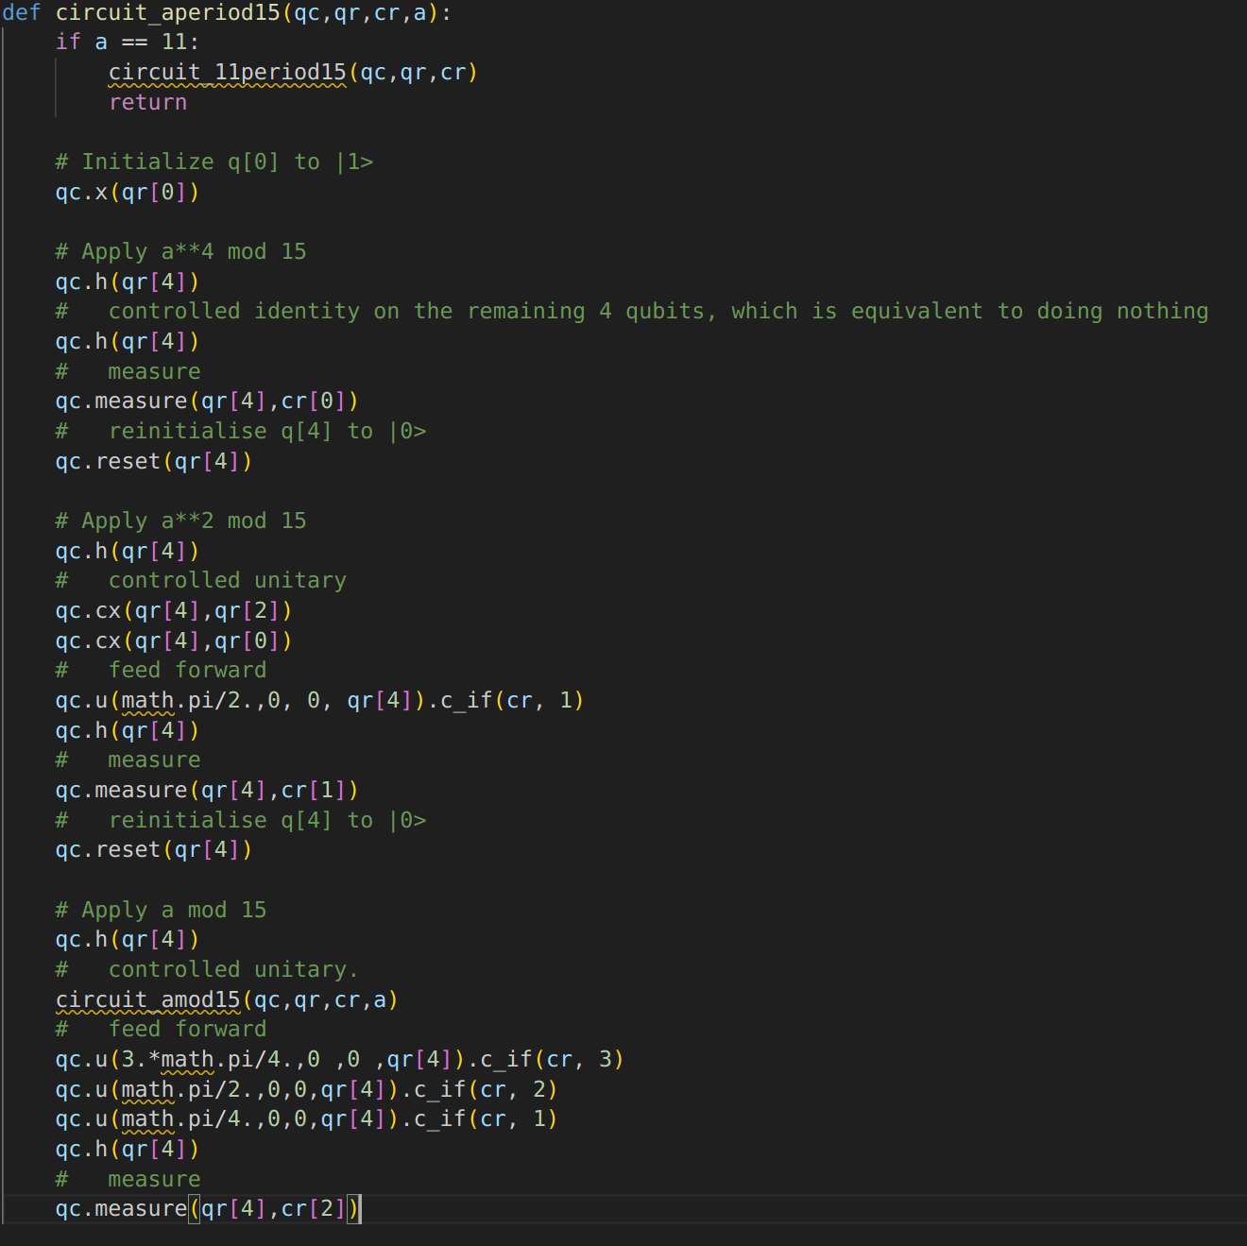
Implementation
Classical Implementation in Ocaml
Qiskit Implementation

Slide 17
Functional Quantum Algorithm Framework for Shor’s

Slide 18
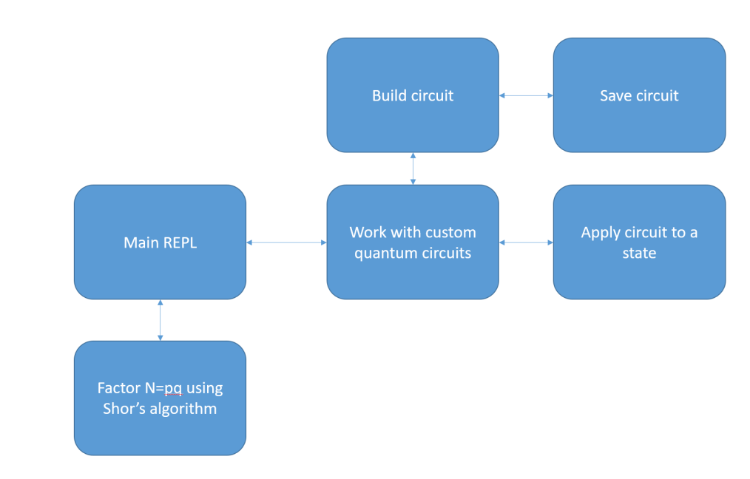
Architecture
At the beginning, users can choose between two options: use shor’s algorithm for factoring or create his own circuit through a REPL.
If the user selects a pre-built circuit, it will processes the input and displays the result.
For custom circuit, users constructs and save the circuit, input the state and then run the algorithm.
The user can also return to the REPL for further action.

Slide 19
System and Module Design
Our architecture comprises five modules, each serving a distinct purpose and interdependent functionality.
Arithmetic Module
State Module
Gate Module
Shor Module
Main Module

Slide 20
1. Arithmetic Module
Consists of required arithmetic and number theoretic functions that are required to implement specific gates and parts of Shor’s factoring algorithm.
Integer exponentiation:
Computes the exponentiation of the integer.
int_exp : int -> int -> int
Integer Exponentiation with Modulus:
Computes the exponentiation of an integer with modulus.
int_exp_mod : int -> int -> int -> int
Bitwise XOR Operation:
Performs a bitwise XOR operation on two digit lists.
add_mod_2 : dlist -> dlist -> dlist
Splitting Digit List:
Splits a digit list into two parts, with the length of the first part specified.
split : int -> dlist -> dlist * dlist
Base 10 Representation:
Converts a number from base b to its base 10 representation.
base_10_rep : int -> dlist -> int

Slide 21
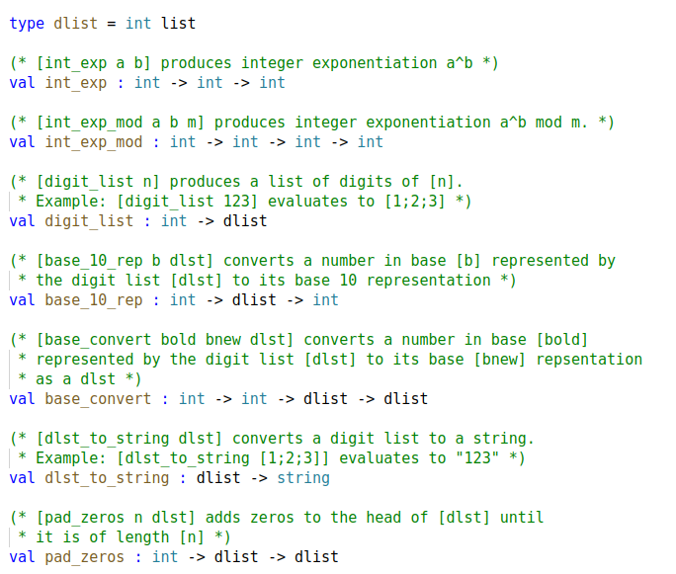

Slide 22
2. State Module (1)
Consists of required types and functions for a quantum state. This will implement qubits in the
quantum computer to be processed by other functions in other modules.
State Type:
Defines the overall type of a state for a certain number of qubits, represented as a tree structure.
type st = Tree of st * st | Node of Complex.t
Creating States:
Generates a state of n qubits from a list of complex numbers, with each coefficient representing the state's amplitude.
make : Complex.t list -> st
Accessing Specific Qubits:
Retrieves the nth qubit from a state, with m number of bits.
state_of : int -> int -> st
Empty State:
Creates an n-bit qubit with all coefficients set to 0.
empty : int -> st
Number of Bits:
Returns the number of bits in a state.
n_bits : st -> int

Slide 23
2. State Module (2)
Tensor Product:
Computes the tensor product of multiple states, creating a composite state.
tensor : st list -> st
Normalization:
Normalizes a state based on the coefficients of its components.
normalize : st -> st
Accessing Specific Qubits:
Retrieves the nth qubit from a state, with m number of bits.
state_of : int -> int -> st
State Operations:
Adds two states and returns the result, not normalized.
add : st -> st -> st
Adds an overall phase to all elements in a state.
phase : float -> st -> st
State Properties:
Returns the coefficients of a state as a list of complex numbers.
coeff : st -> Complex.t list
Returns a formatted string of a state's coefficients.
val_string : st -> string

Slide 24
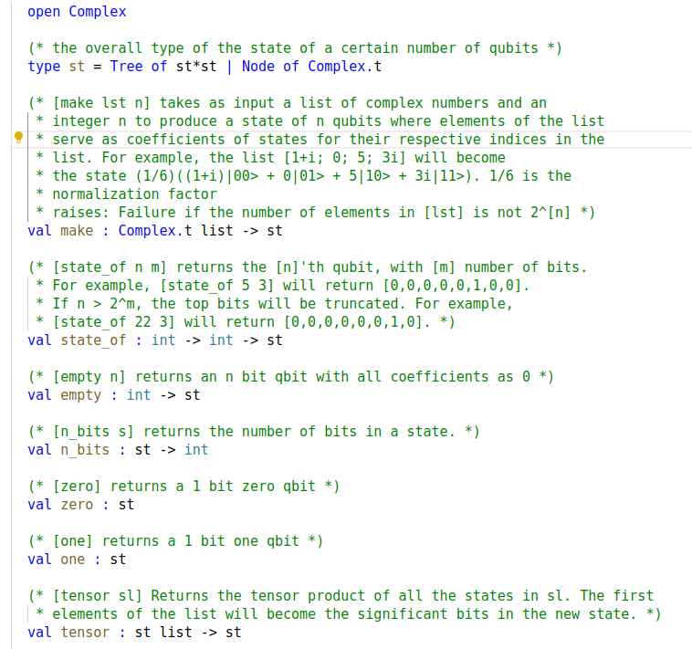

Slide 25
3. Gate Module
Gate Type:
Defines the overall type of an n-qubit gate.
type t
Creating Gates:
Constructs a gate based on an input string that specifies the gate type and the qubits it acts upon.
gate_of : string -> t
Controlled Gates:
Generates a gate controlled by specified qubits, ensuring all control qubits are active for the gate to be effective.
control : int list -> t -> t
Applying Gates:
Applies a gate to a given state, producing the resultant state.
apply : t -> st -> st
Composite Gates:
Computes the tensor product of multiple gates, defining a composite gate where gates are applied sequentially.
product : t list -> t

Slide 26
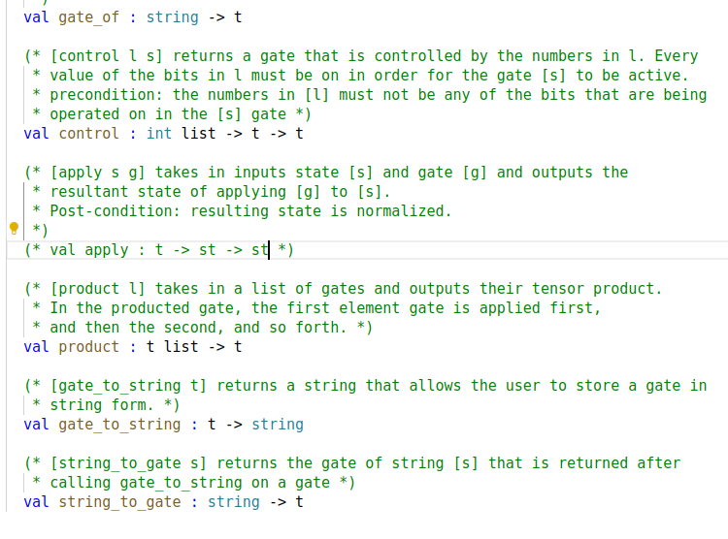

Slide 27
4. Shor Module
Factoring Function:
Factors an integer using Shor's algorithm and efficient classical algorithms, printing statistics comparing their efficiency.
factor : int -> unit
Quantum Fourier Transform Gate:
Generates a quantum Fourier transform (QFT) circuit as a single gate, specifying the number of qubits involved in the QFT out of the total number of qubits.
qft_gate : int -> int -> Gate.t

Slide 28
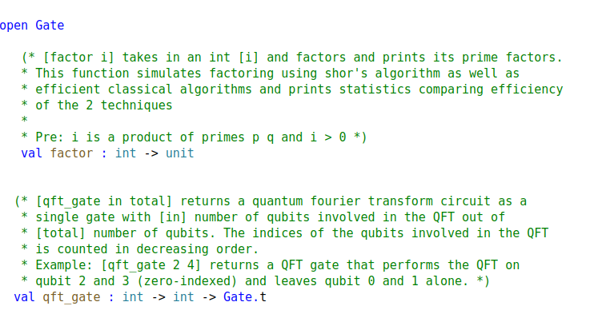

Slide 29
5. Main Module
REPL (Read-Eval-Print Loop):
The REPL provides users with two primary choices:
Building quantum circuits and applying states to them
Factoring integers using Shor's algorithm
Building Quantum Circuits
Users can build quantum circuits by listing out gates or sequences of gates separated by spaces.
They can save the circuits they've built and view currently available circuits.
The format for entering gates is provided, guiding users on how to construct quantum circuits.
Applying Gates to States
Users can apply saved circuits to states, observing the resulting state after passing through the circuit.
They can view available circuits, apply gates, or quit this mode.
Integration with Shor's Algorithm
Users can factor natural numbers using Shor's algorithm, with the program providing statistics comparing its efficiency with classical algorithms.
This functionality relies on the Shor module.

Slide 30
Comparing Functional & Imperative Implementations in QC

Slide 31
Advantages of Functional Paradigms in QC
Immutable State: Functional programming emphasis on immutability is a big plus for quantum programming, ensuring that states remain stable and reducing the risk of unintended changes.
Higher-Order Functions: Using higher-order functions enables concise and expressive code for quantum operations. Functions can be passed as arguments, allowing for dynamic gate creation and manipulation, thus enhancing flexibility in quantum algorithm design.
Concurrency and Parallelism: Functional programming encourages a stateless, side-effect-free approach, making it inherently well-suited for concurrent and parallel execution. In quantum computing, where operations often occur simultaneously or in parallel, functional paradigms facilitate efficient resource utilization and scalability.

Slide 32
Challenges of Functional Paradigms in QC
Performance Overhead: Functional programming tools like higher-order functions and immutable data structures might slow down performance, especially in heavy quantum simulations or computations, compared to imperative methods.
Learning Curve: Quantum programming itself presents a steep learning curve, and adopting functional paradigms adds another layer of complexity for developers.
Debugging and Testing: Functional programming encourages the use of pure functions, which lack side effects and rely solely on input parameters. While this enhances predictability and testability, it may complicate debugging processes, especially in complex quantum algorithms.

Slide 33
Challenges Faced:
Implementation Limitation: Significant portion of our time was given to learning the foundational concepts of quantum computing theory, such as quantum states, gates etc. Understanding these theoretical aspects consumed the majority of our allocated time, leaving limited resources for actual implementation.
Internal Operation: We're familiar with the input and output of methods in Qiskit, IBM's quantum computing library, but lack insight into its internal workings. This knowledge gap poses a challenge as efficient internal processes are crucial for handling different quantum computations like parallelism.

Slide 34
Thanks!
Do you have any questions?

